Slide 1
Marketing Our Products:
Customizable Flyers
HousingBuildsNC.com

Slide 2
It’s easier than ever to market your provision of our
NC Home Advantage Mortgage Products with our customizable flyers.
All fliers are available in downloadable formats so they can easily be printed out for your clients.
Most fliers are available in three versions: print, customizable with one business card and customizable with two for those of you cobranding.
HousingBuildsNC.com

Slide 3
LET’S GET STARTED!
HousingBuildsNC.com

Slide 4
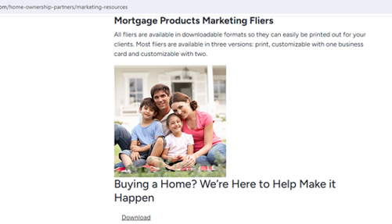
Visit our website to view marketing resources
Click Download
HousingBuildsNC.com

Slide 5
FOLLOW THESE INSTRUCTIONS:
Click on 'download' to download the zip folder.
Expand the zip file. There will be English and Spanish versions within the zip file. Then there is a print version, a customizable flier with one business card and with two options to upload to file. Depending on which version you need, save that file for your use.
You will need to open directly in Adobe Acrobat to customize the flier.
In Adobe Acrobat, click on the image icon in the white box on the bottom of the page.
Browse to find the file of your business card or document you’d like to insert. (File types that are acceptable: .jpg; .tif; .png; .pdf)
Select Image and Press Ok.
Your Image should be saved and fitted into the box.
Save the file to save your changes.
HousingBuildsNC.com

Slide 6
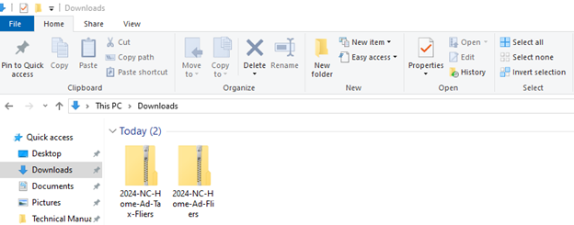
Once downloaded, the zip folders will be in your file explorer on your computer
HousingBuildsNC.com

Slide 7
Double click each folder to open it
Step 1
Step 2
HousingBuildsNC.com

Slide 8
Open the PDF with Adobe Acrobat
HousingBuildsNC.com

Slide 9
Click in the white box on the bottom of the page
HousingBuildsNC.com

Slide 10
A Select Icon tool will open up
HousingBuildsNC.com

Slide 11
Select browse and then choose the file format your business card is in
(Files that are acceptable: .jpg; .tif; .png; .pdf)
HousingBuildsNC.com

Slide 12
Select the image and press OK
HousingBuildsNC.com

Slide 13
Your image should be saved and fitted into the box
HousingBuildsNC.com

Slide 14
Save the files to save your changes
HousingBuildsNC.com

Slide 15
Final step? Get those fliers into the hands of your clients!
HousingBuildsNC.com

Slide 16
We have many resources to help you explain our products on our website under “Marketing Resources for Partners”
Remember to check out our Marketing Policies and Guidelines when developing your own marketing campaigns that mention our products.
HousingBuildsNC.com

Slide 17
Any questions?
Contact pressoffice@nchfa.com
HousingBuildsNC.com

